Slide 1
Fabric Introduction and Process Flow
January 21st 2025

Slide 2

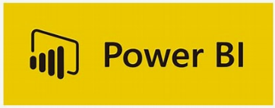
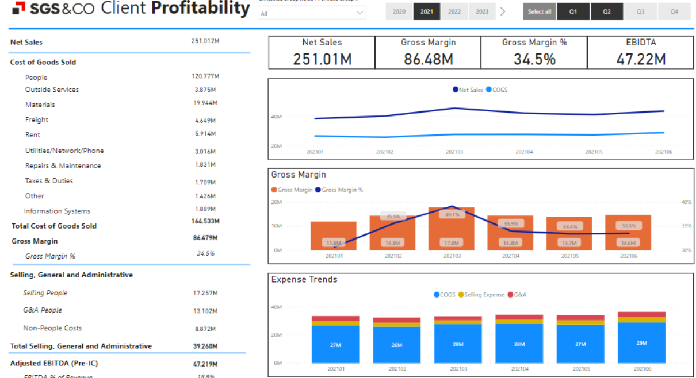

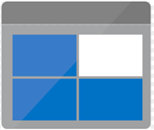
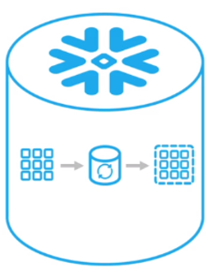


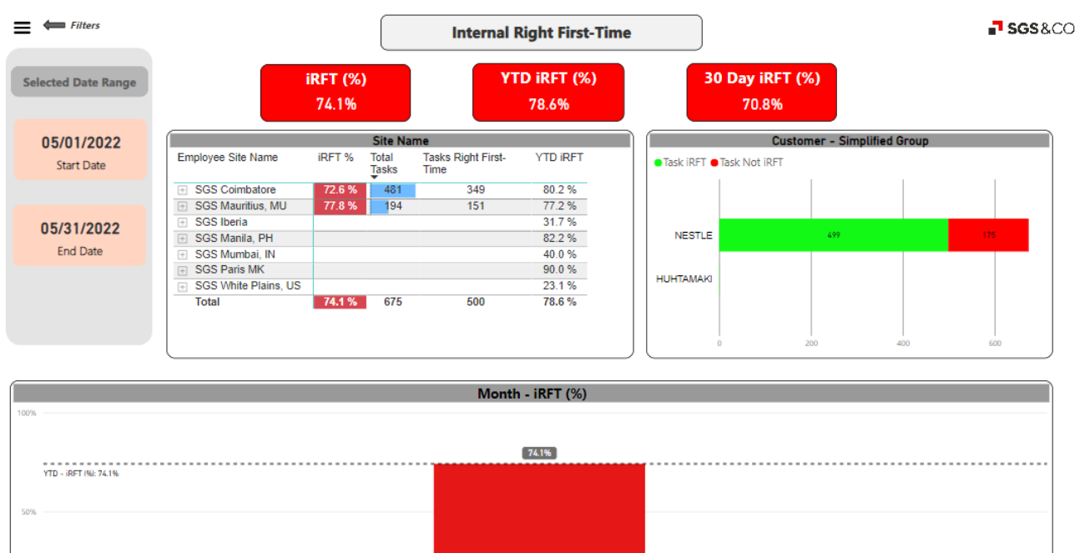
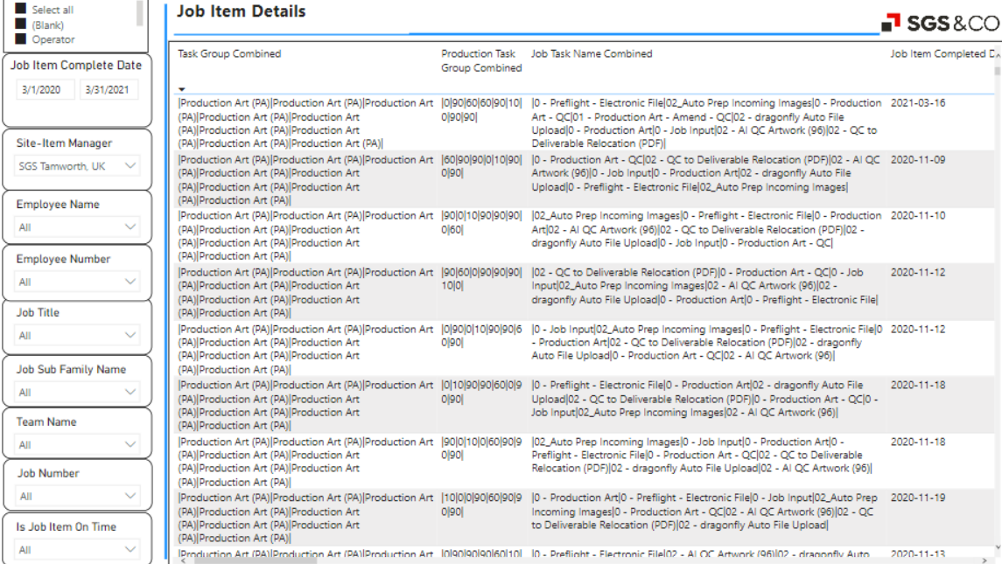

Previous Process
ADLS
ADF
ADF
Full
Processing
Blob Storage
External Table
CP Report
10.129.25.4
ADF
ADF
Physical Table
Delta
OPS KPI Report
10.8.10.15
Blob Storage
External Table
Others

Slide 3
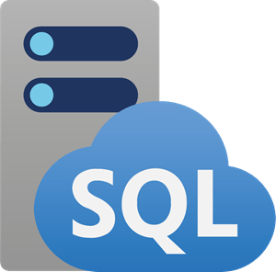
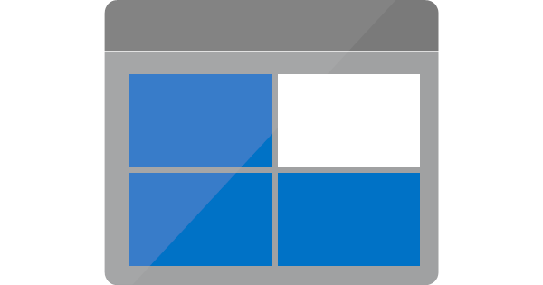

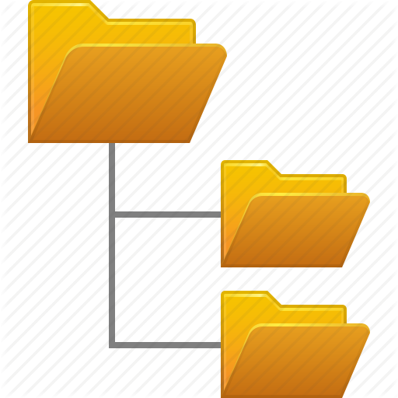
Phase-1:
Extract And Transform
ADF
Azure Blob Storage
inbound
Full Load
tbl_job_items
MYSGSEU_tbl_job_items.csv
tbl_customers
MYSGSEU_tbl_customers.csv
Delta Load
Warehouse Staging
ADLS

Slide 4
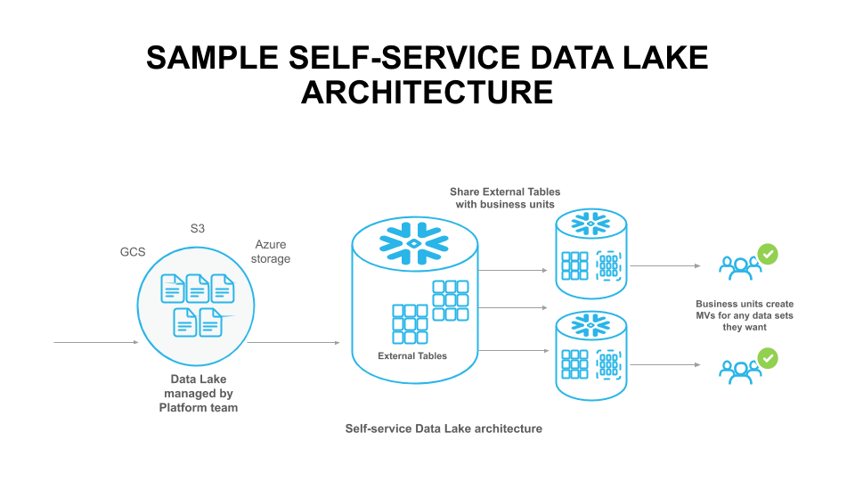
Phase-2:
Extract And Transform
External Table
FULL DATA
Azure Blob Storage
inbound
Full Load
tbl_job_items
MYSGSEU_tbl_job_items.csv
tbl_customers
MYSGSEU_tbl_customers.csv
Delta Load
DELTA DATA
ADLS
Staging

Slide 5
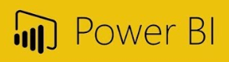

Step-3:
Dimensional-Modelling And Visualisation
DBO
FULL DATA
+
Subset BI Report
Master BI Report
Subset BI Report
DELTA DATA
Transformation Staging
Dimensional - Modelling
Visualization

Slide 6
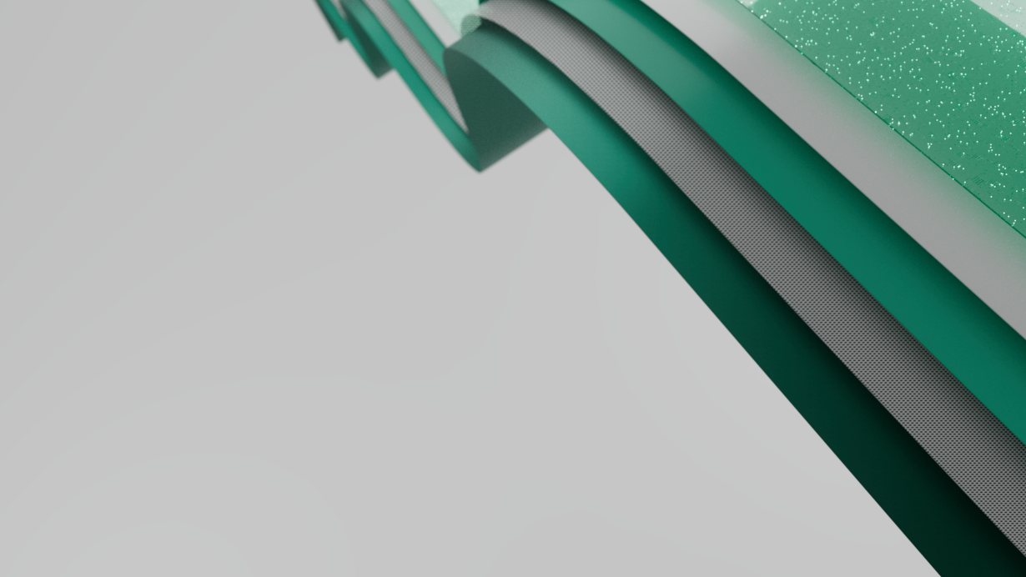
Introduction to Microsoft Fabric

Slide 7
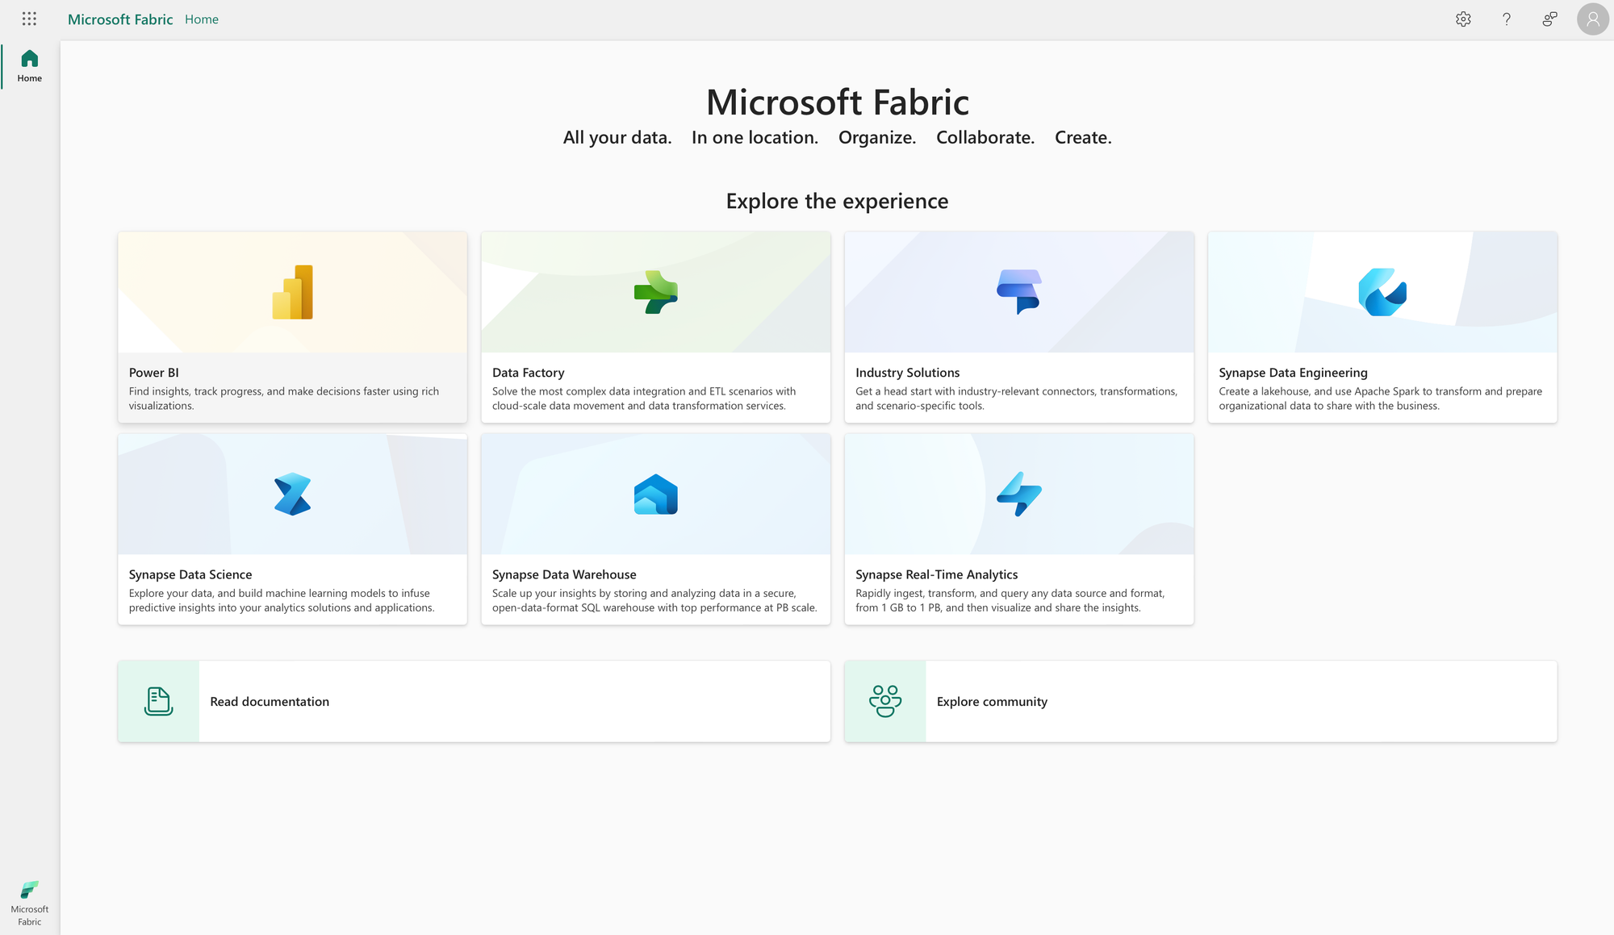
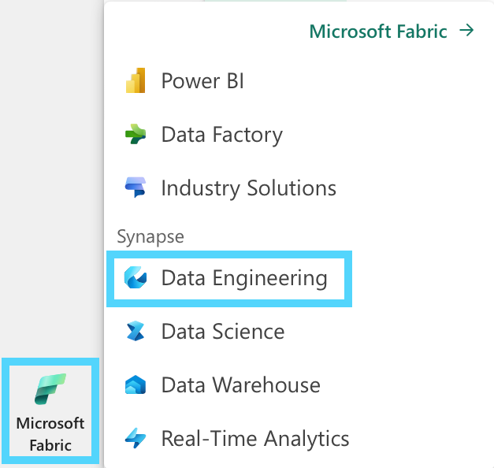
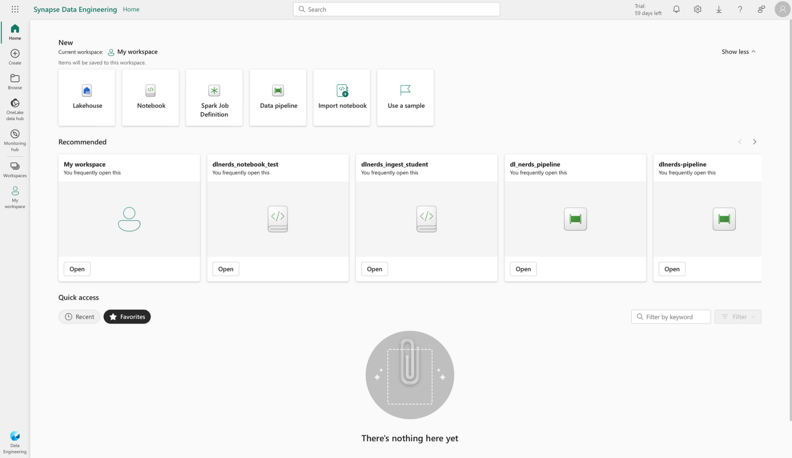
Introduction
Microsoft Fabric is a powerful All-in-One Data Platform (SaaS) in the Azure Cloud that combines various Azure components to cover the fields of Data Integration, Data Engineering, Data Science and Business Intelligence. One key component of the Microsoft Fabric architecture is the Lakehouse. In this tutorial, we will explain step-by-step how to create a lake house in Fabric.

Slide 8
Lakehouse
What is lake house A Lakehouse is a modern data management architecture that combines the best features of data lakes and data warehouses into a unified system. It aims to provide the scalability and flexibility of data lakes with the performance and reliability of data warehouses, addressing the challenges of traditional data architectures.
Key Features of a Lakehouse
Unified Architecture:
Combines raw and structured data storage.
Eliminates the need for separate data pipelines between a lake and a warehouse.
Support for All Data Types:
Handles structured (e.g., tables), semi-structured (e.g., JSON, Parquet), and unstructured data (e.g., images, videos).
Transaction Support:
Offers ACID transactions for consistent and reliable data updates.
Data Governance and Security:
Includes features like role-based access, data masking, and lineage tracking for compliance.
Performance Optimization:
Leverages caching, indexing, and query optimization for fast analytics.
Machine Learning and AI Integration:
Enables seamless access to raw data for advanced analytics, AI, and ML without extensive preprocessing.

Slide 9
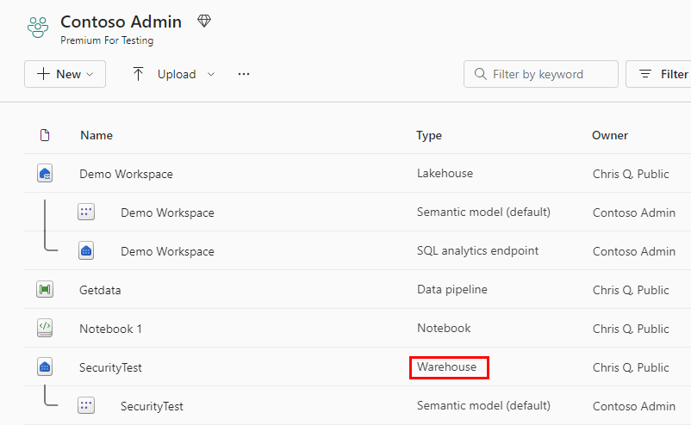
Fabric Data Warehouse
In a Microsoft Fabric workspace, a Fabric warehouse is labeled as Warehouse in the Type column. When you need the full power and transactional capabilities (DDL and DML query support) of a data warehouse, this is the fast and simple solution for you.

Slide 10
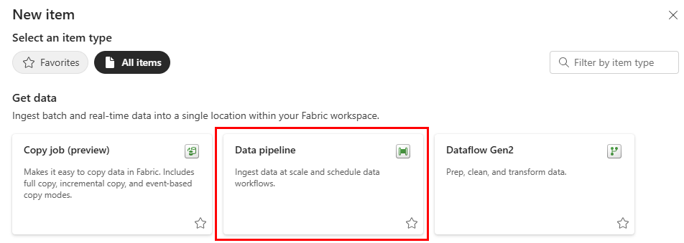
Fabric Data Pipeline
A data pipeline is a logical grouping of activities that together perform a data ingestion task. Pipelines allow you to manage extract, transform, and load (ETL) activities instead of managing each one individually.

Slide 11
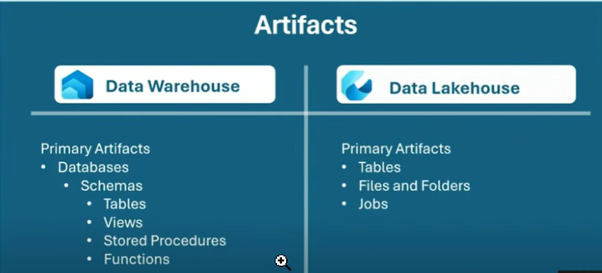
Artifacts

Slide 12




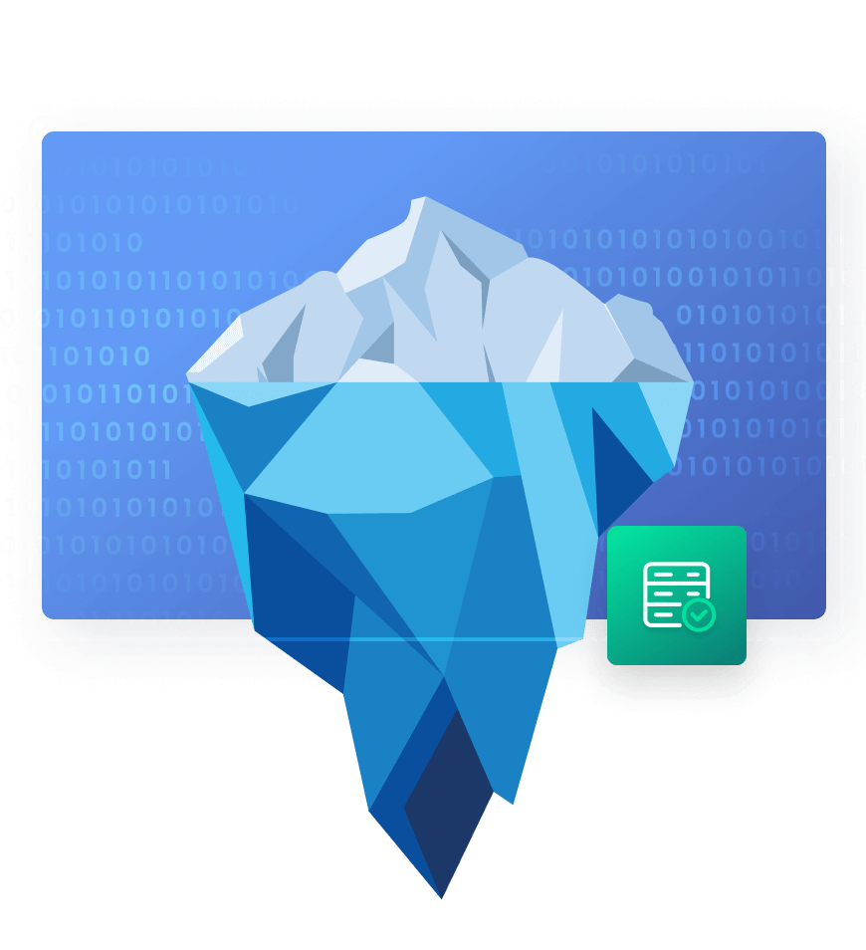
To be Process
Processing
ADF
Full
10.129.25.4
CP Report
ADF
Iceberg
Delta
OPS KPI Report
10.8.10.15
Notebook
Silver Lakehouse
Bronze Lakehouse
Transformation Layer
Others

Slide 13
Fabric In Data Engineer
Data pipelines and movement
Data storage and architecture
Delivering data to data analysts and data Engineering
Notes:
We will cover three areas: first data pipelines and movement, then data storage and architecture, and finally delivering data to data analysts and data scientists.

Slide 14




The choice of tools for your data transformations
Spark Job
Definitions
Data Flows
Notebooks
Data pipelines
Code-based pipelines
UI-based pipelines

Slide 15
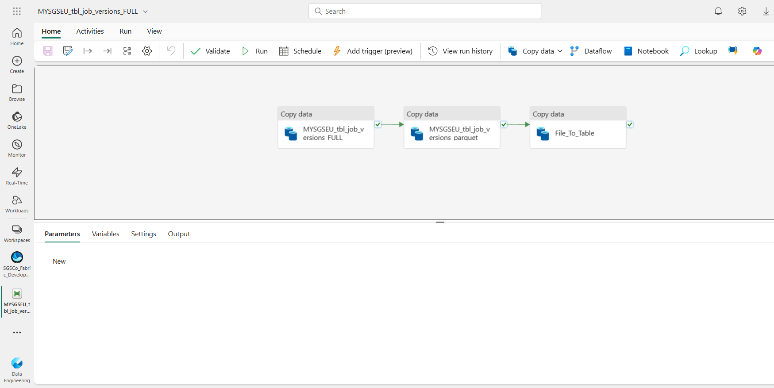
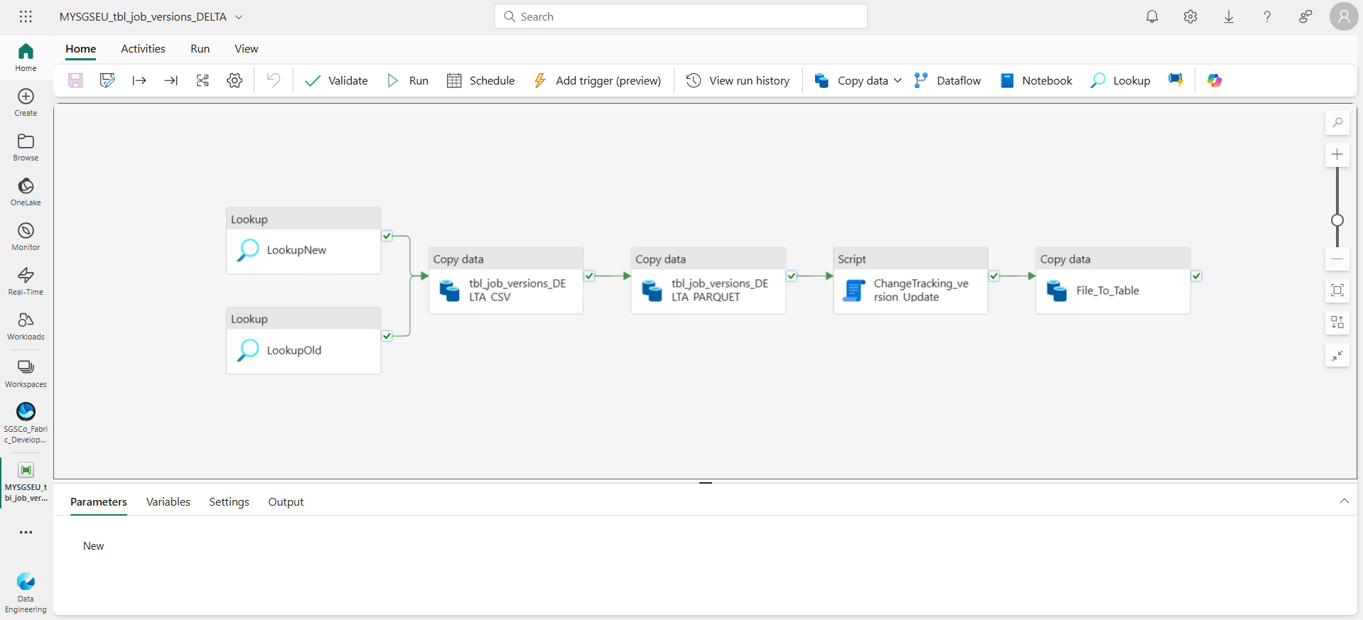
Data Pipelines
Full Fabric Pipeline in ADF
Delta Fabric Pipeline in ADF

Slide 16

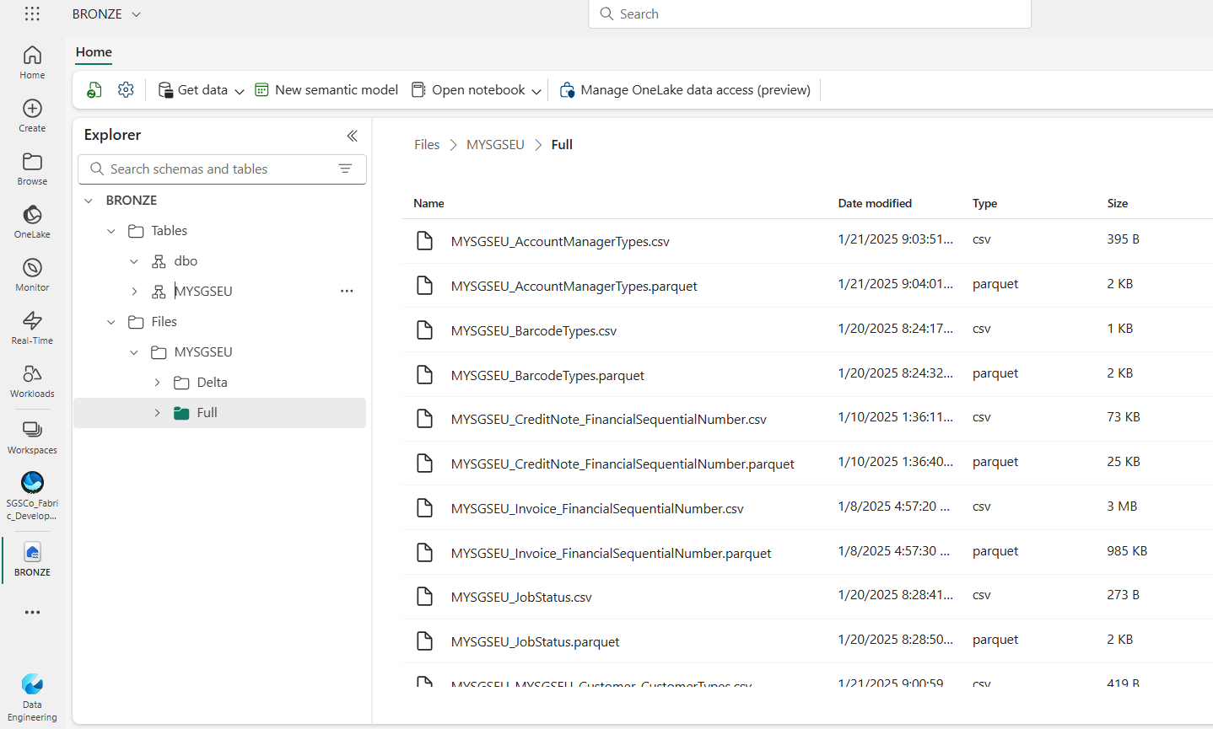
One Lake working with both files and tables
One Lake
Unified lake house
Based on open standards
Accessible from any workload

Slide 17
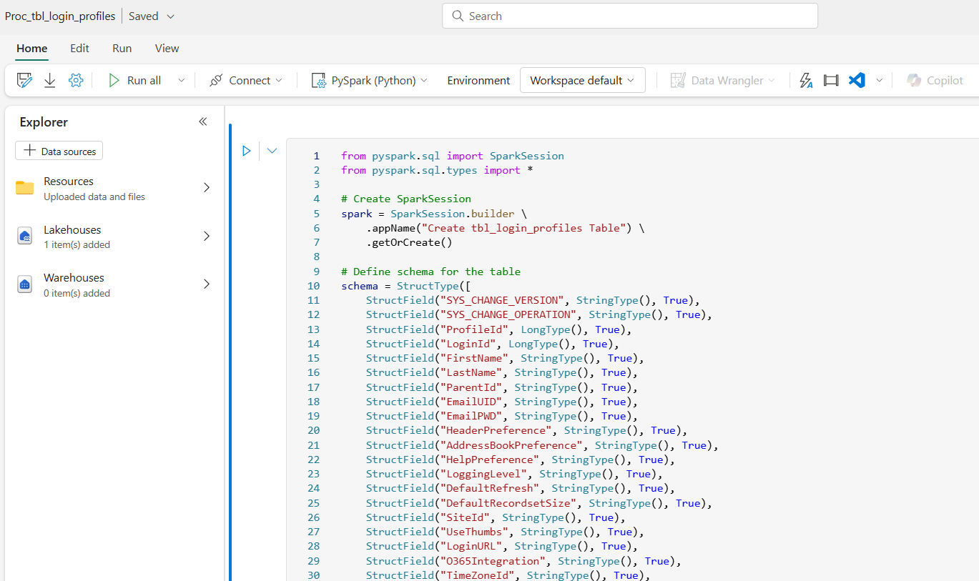
Notebook Silver Layer

Slide 19
APPENDIX

Slide 20
List of 180 Tables in Data Lake (MYSGSEU)
tbl_job_items
tbl_job_tech_spec_checklist_responses
tbl_job_task_history
tbl_job_extra_details
tbl_job_tasks
tbl_job_status_audit_trail
tbl_job_tech_spec_colours
tbl_job_tech_spec_checklist_revisions
tbl_invoice_items
tbl_job_account_managers
tbl_job_contacts
tbl_job_teams
tbl_job_stages
tbl_job_kpi_data
tbl_job_versions
tbl_job_tech_spec
tbl_job_stage_reason
tbl_invoices
tbl_invoice_ex
tbl_job_tech_spec_checklist_amends
tbl_job_items_patches
tbl_job_ranges
tbl_price_matrix_items
tbl_customer_contacts
tbl_projects
tbl_job_stage_reason_faults
tbl_customers
tbl_login_profiles
tbl_logins
tbl_DAX_customers
tbl_customer_portfolio_groups
tbl_customer_simplified_groups
tbl_customer_simplified_groups
tbl_customer_group_members
tbl_extra_details_fields
tbl_price_matrix
tbl_teams
tbl_production_tasks
tbl_kpi_types
tbl_sales_account_codes
tbl_workflow_template
tbl_extra_details
tbl_plate_types
tbl_countries
tbl_customer_groups
tbl_price_matrix_variants
tbl_sites
tbl_sales_department_codes
tbl_price_matrix_multipliers
tbl_new_stage_reason_codes
tbl_sales_tax_codes
tbl_sites_companynumbers
tbl_order_type
tbl_currencies
tbl_plate_thickness
tbl_package_type
tbl_customer_complaint_fault_types
tbl_new_stage_reason_found_on
tbl_job_item_due_reason_codes
tbl_region
tbl_job_relationship
Customer_ChangeCategoriesAmends
Customer_CustomerTypes
Job_JobStatus
tbl_projects
Job_AccountManagerTypes
Job_JobColourSetColours
Job_JobItemColourPlateDimensions
Job_JobStatus
Job_PrintProcess
Production_BarcodeTypes
Link of 180 Data Lake Table lists
Fabric Tables

Slide 21
As Is Process
External Table Process
ADF
Full
Processing
Blob Storage
External Table
CP Report
ADF
Physical Table
Delta
OPS KPI Report
Blob Storage
External Table
Others

